Slide 1
Don’t Wreck My House
Sammi Chong

Slide 2
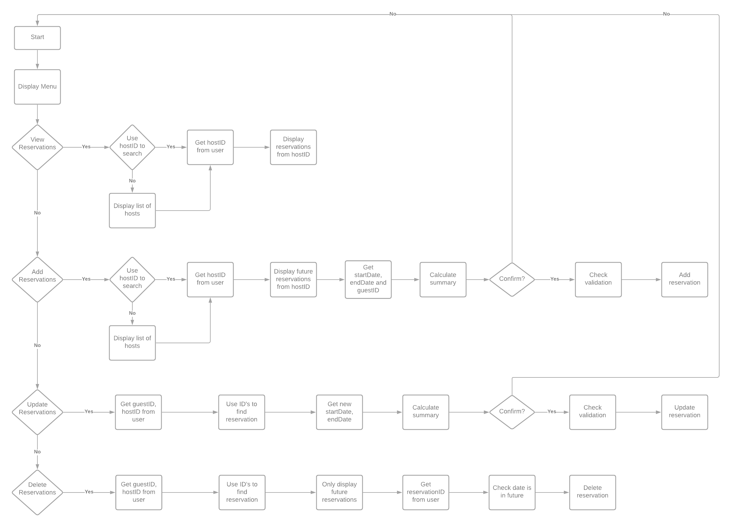

Slide 3
